Slide 1
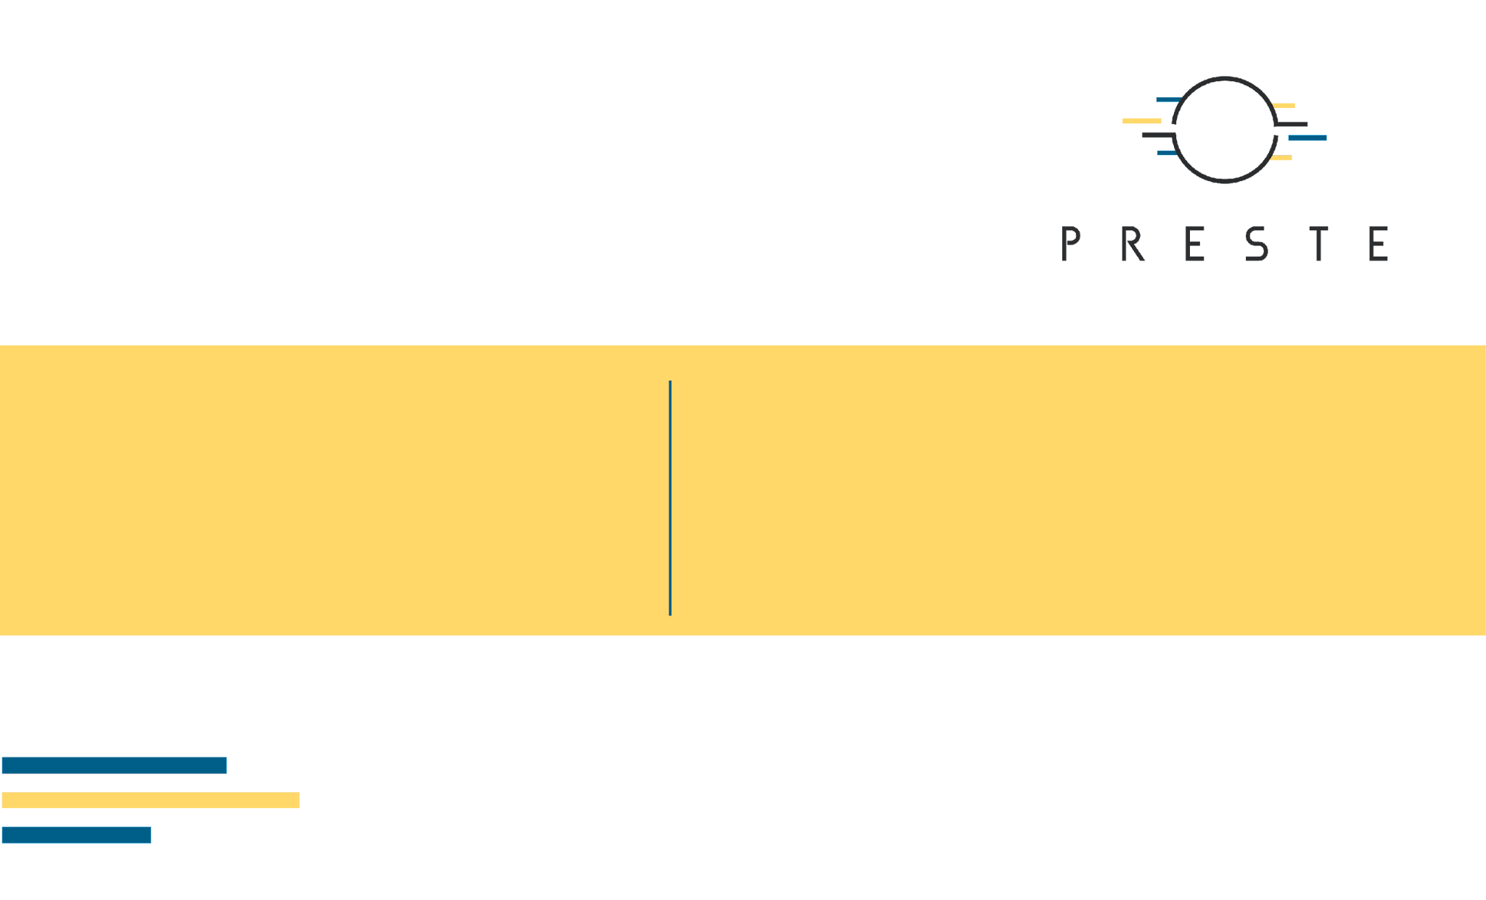
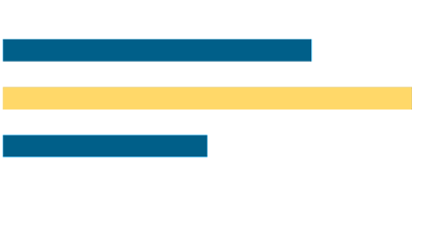
From Statistical Relationships
to Predictive Models
Correlation · Linear regression · Assumptions · Loss · Evaluation

Slide 2

What's for today
Inspect
Statistics
Model fit
Diagnose
Evaluate
Data preparation
Correlation
Simple/multiple
Assumptions
Metrics

Slide 3

1. From variation to relationships

Slide 4
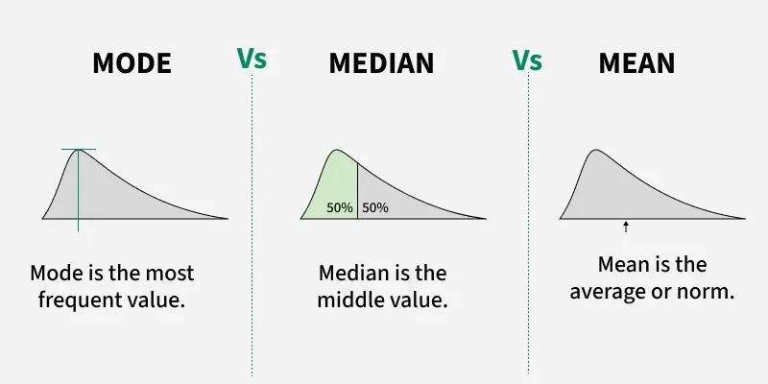
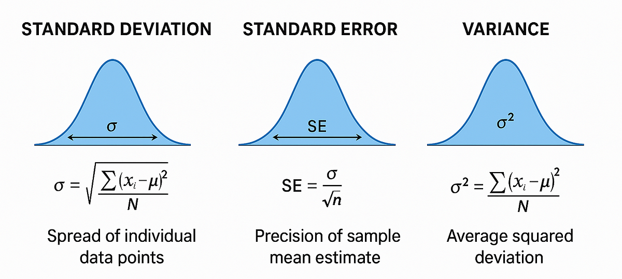
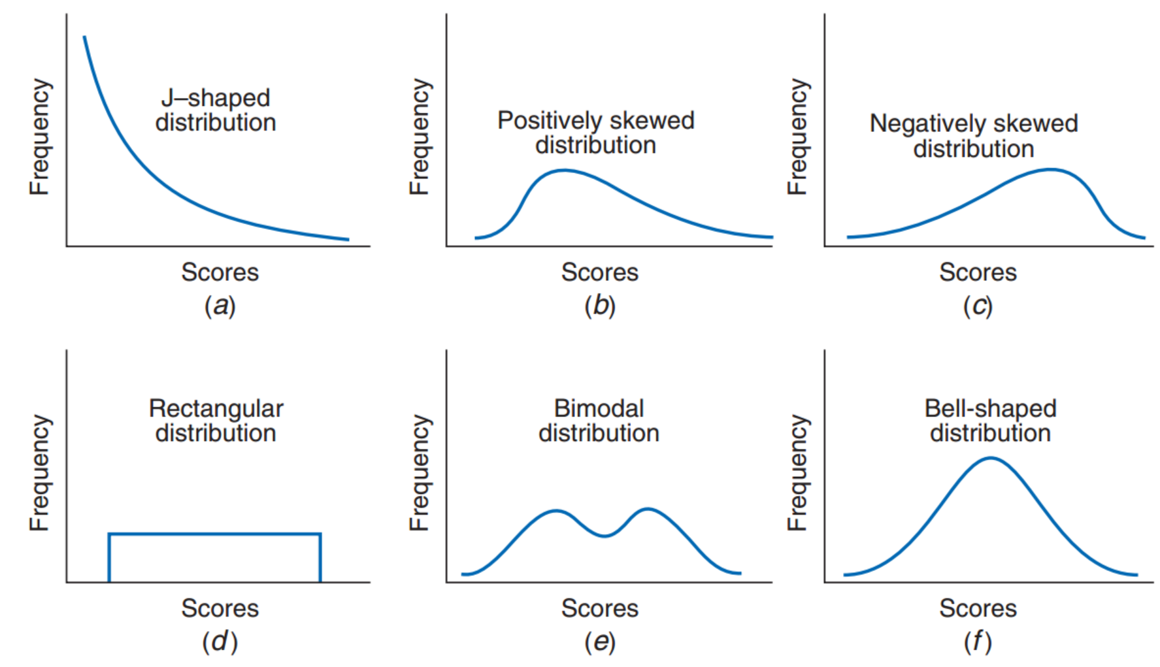
First step - EDA
Center
Spread
Shape
Mean
Median
Mode
Variance
SD
SE
IQR
Symmetry - skew
Multimodality
outliers

Slide 5
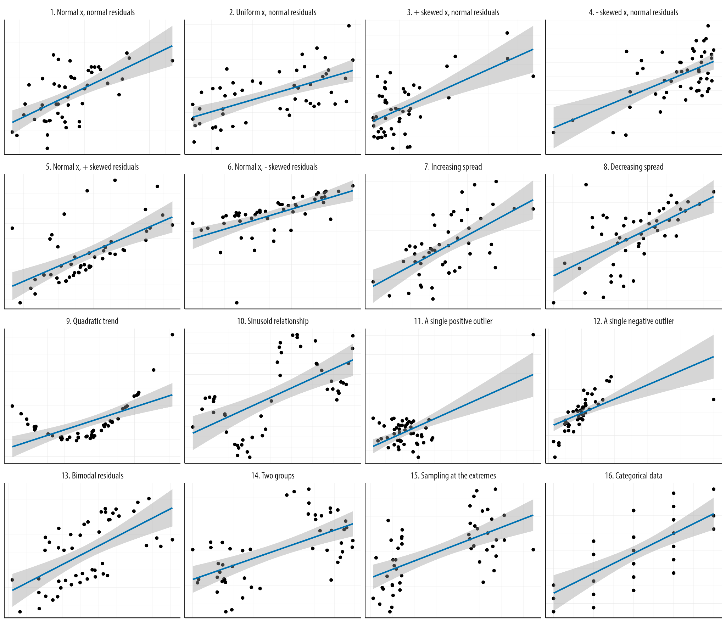
Visualizations still useful

Slide 6

2. Correlation and confounding
Quantifying association and why it might be useless

Slide 7
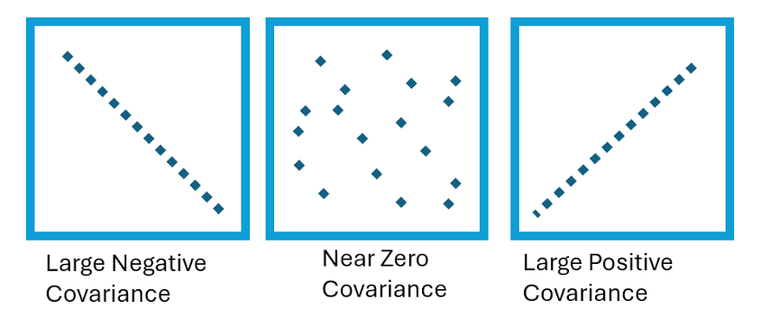
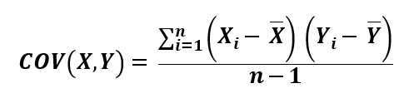
Covariance asks whether two variables move together
Cov > 0
Cov ~ 0
Cov < 0
Large X tends to occur with large Y.
No consistent linear co-movement.
Large X tends to occur with small Y.

Slide 8


Correlation - standardized covariance
Pearson correlation
Spearman correlation
Works on measured values.
Best interpreted as strength of a linear relationship.
Can be strongly affected by extreme observations.
Works on ranks.
Measures monotonic association.
Useful when the relationship is ordered but not linear.

Slide 9
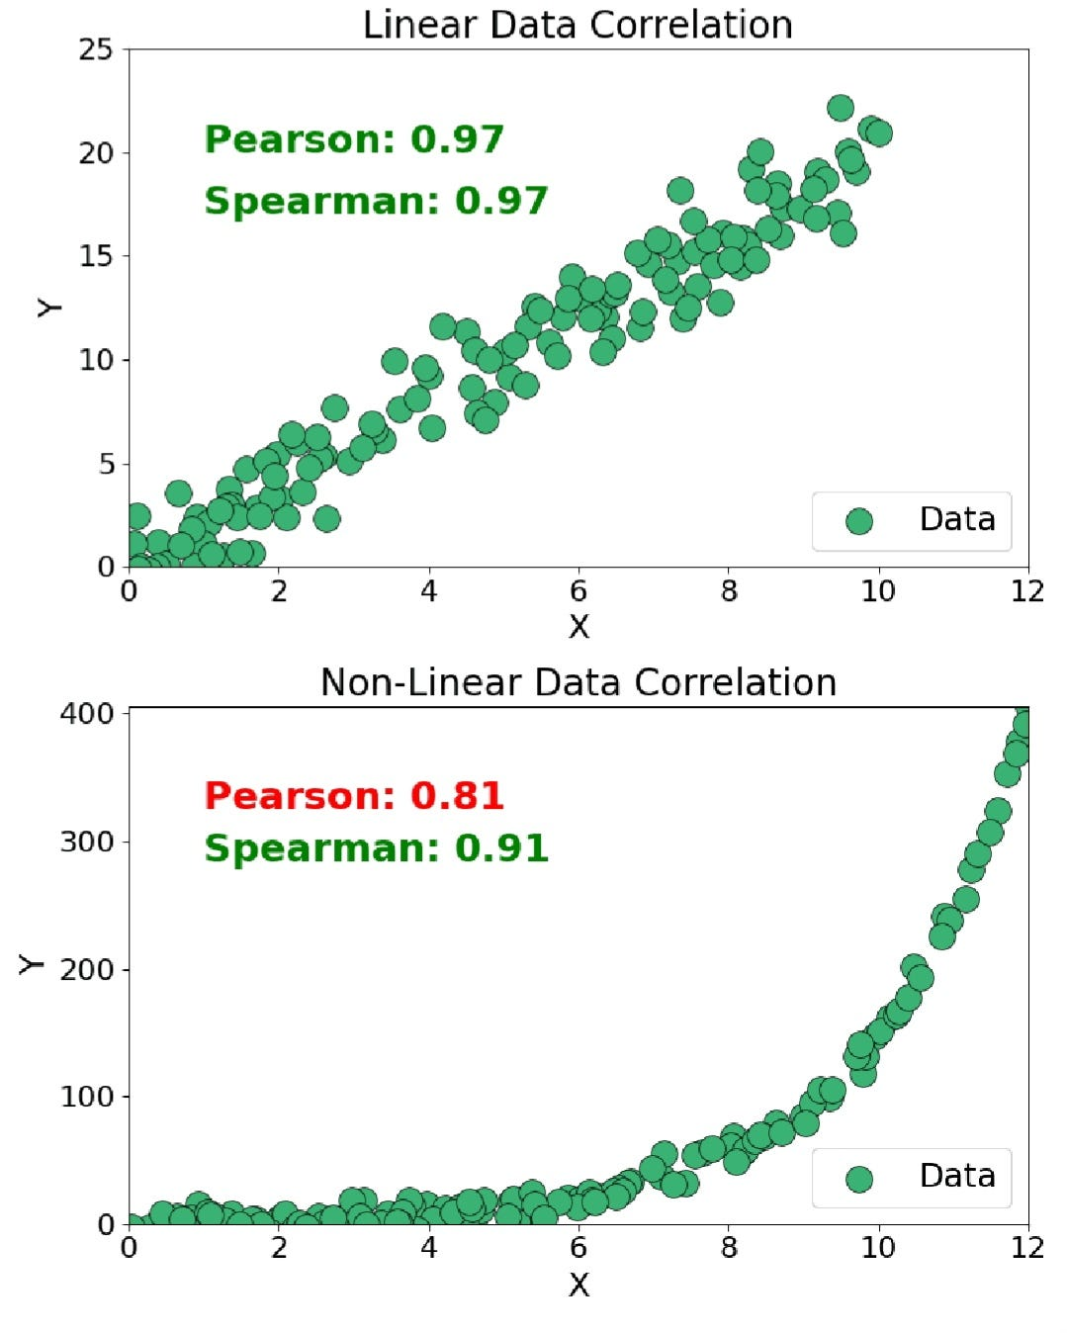
Correlation - standardized covariance
Pearson correlation
Spearman correlation
Works on measured values.
Best interpreted as strength of a linear relationship.
Can be strongly affected by extreme observations.
Works on ranks.
Measures monotonic association.
Useful when the relationship is ordered but not linear.

Slide 10

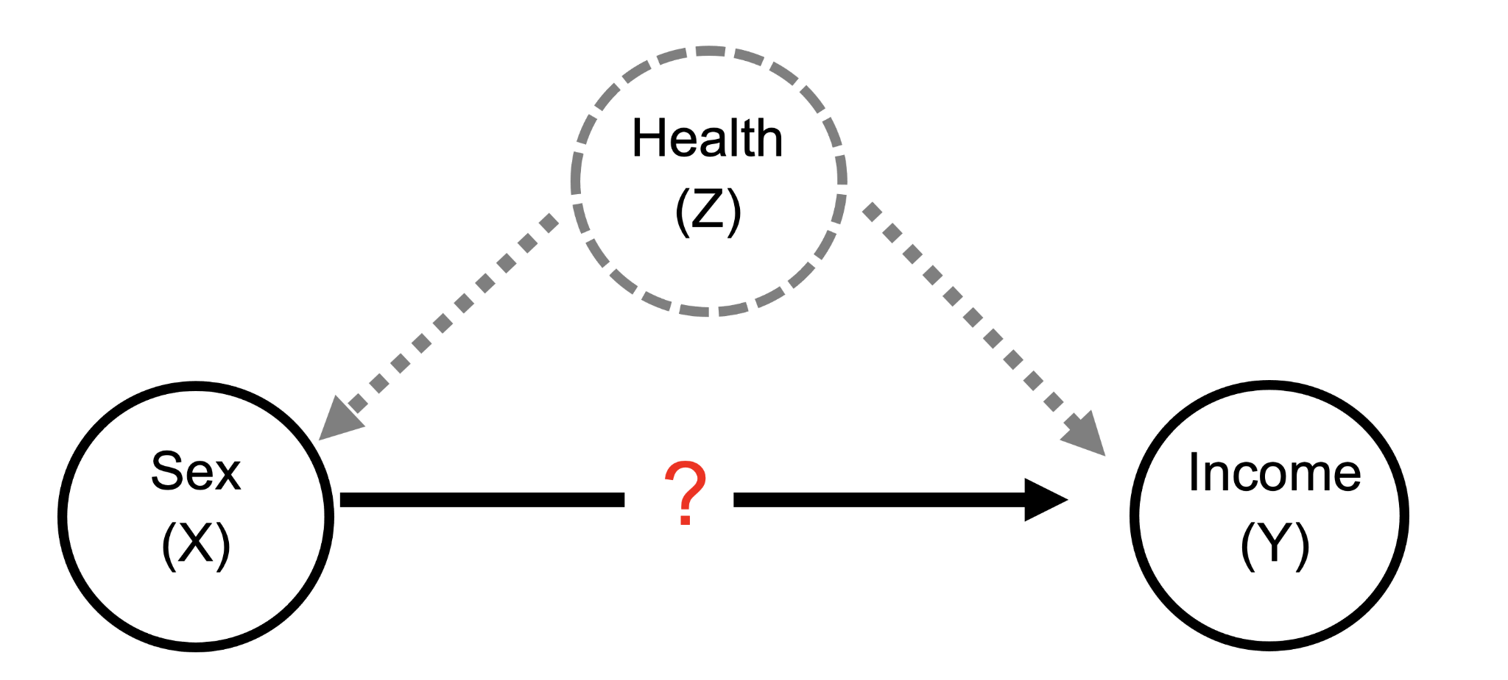
Correlation is not causation - check for confounders

Slide 11

3. Linear regression and residuals
Residuals are actually useful.

Slide 12
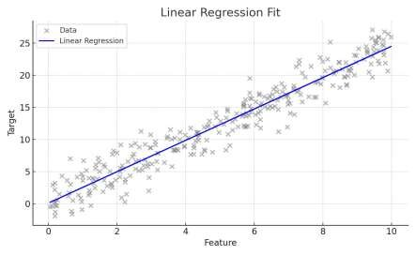
Regression turns a relationship into a predictive function
ŷ = β₀ + β₁x + ε
β₀
β₁
x
ŷ
ε
Intercept: predicted y when x = 0.
Slope: expected change in y per unit x.
Input / predictor.
Model prediction.
Technical variation

Slide 13
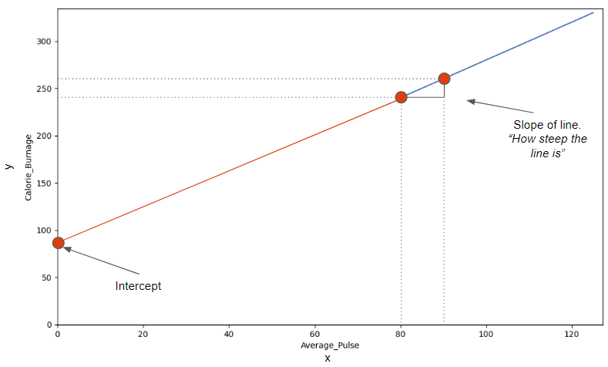
The slope is an effect on the scale of the model
Biological interpretation
If x is pulse and y is energy consumption, β₁ estimates the expected change in energy consumption for one unit increase in pulse — under the linear model.

Slide 14
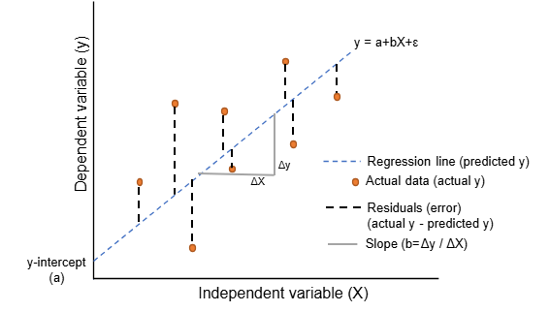
Residuals are what the model fails to explain
eᵢ = yᵢ − ŷᵢ
Why residuals matter
Residuals reveal systematic errors, changing variance, outliers and missing structure. They are central to regression diagnostics.

Slide 15

4. Loss and optimization
Training means choosing parameters that minimize a defined objective.

Slide 16
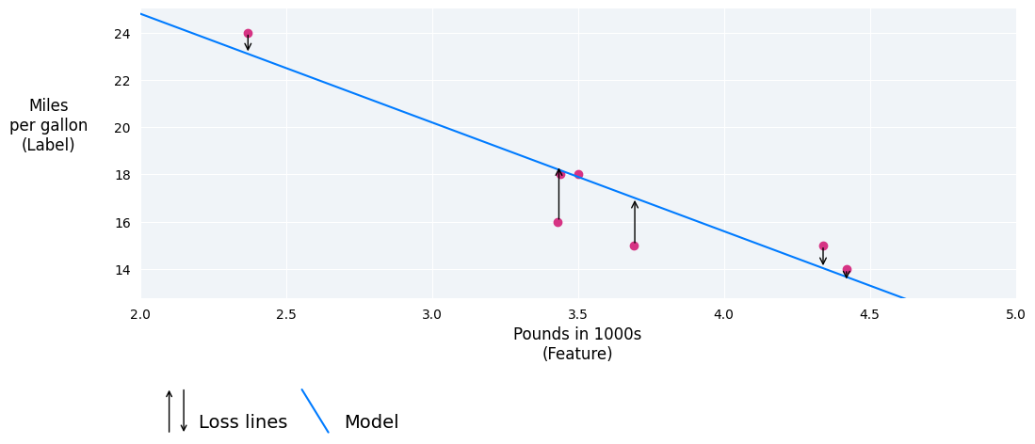
Loss function
Squared error = (yᵢ − ŷᵢ)²
MSE = (1/n) Σᵢ (yᵢ − ŷᵢ)²

Slide 17
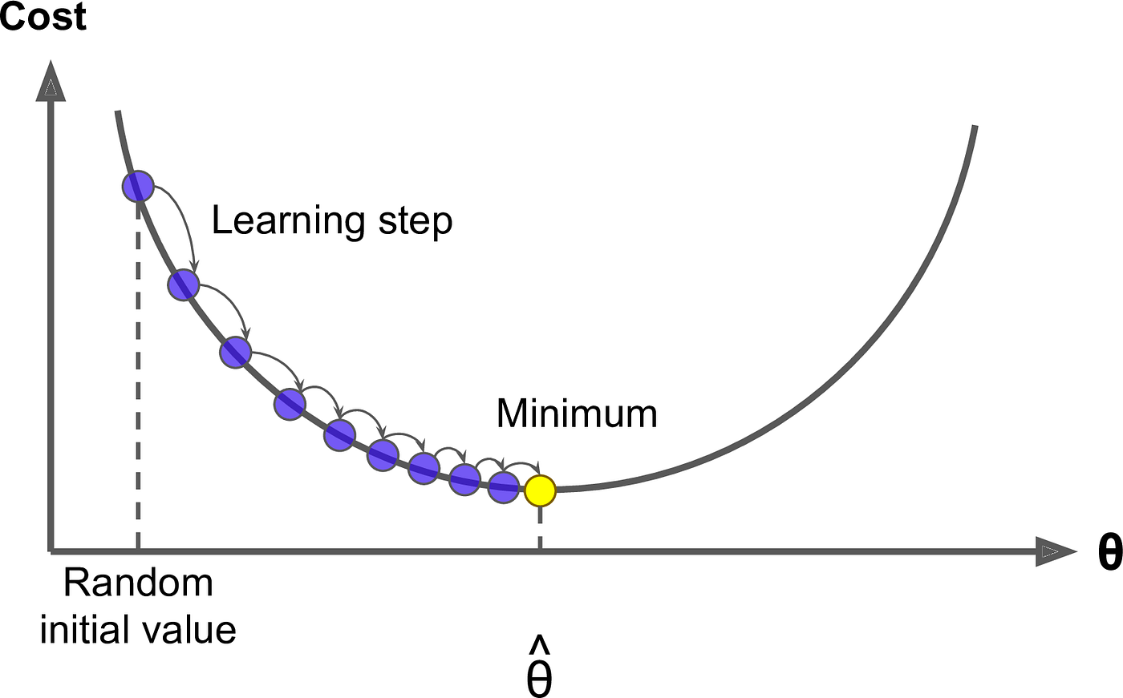
Gradient descent
θₜ₊₁ = θₜ − η ∇L(θₜ)
θ = model parameters
η = learning rate
∇L = local direction of increasing loss

Slide 18
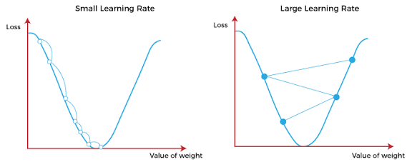
Learning rate controls the size of each update
Too small
Useful scale
Too large
Stable but slow.
Many iterations may be needed.
Loss decreases efficiently toward a minimum.
Never converges, hard to find optimum

Slide 19

5. Beyond one numerical predictor
Multiple variables, categories and interactions.

Slide 20
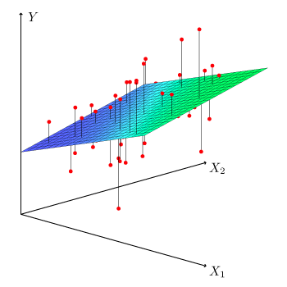
Multiple linear regression uses several predictors
ŷ = β₀ + β₁x₁ + β₂x₂ + … + βₚxₚ
x₁
Gene A expression
x₂
Gene B expression
x₃
Age

Slide 21
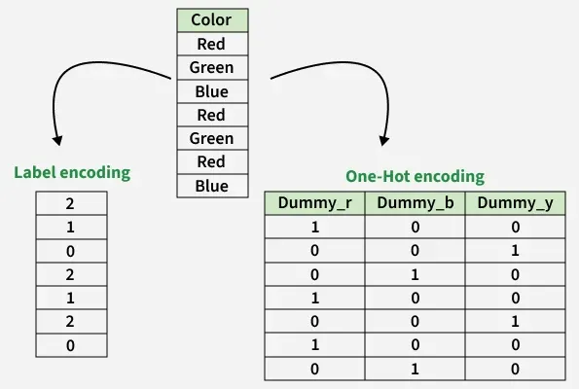
Categorical predictors need a numerical representation
ŷ = β₀ + β₁_A + β₂_B

Slide 22
Interactions ask whether one effect depends on another variable
ŷ = β₀ + β₁Treatment + β₂Sex + β₃(Treatment × Sex)
Without interaction
With interaction
The treatment effect is assumed to be the same across groups.
The effect of treatment may differ by sex, genotype, environment, dose, etc.

Slide 23
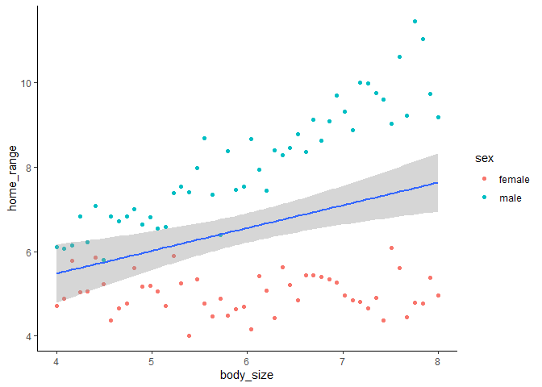
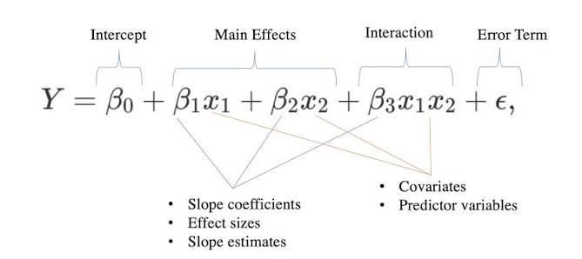
Interactions ask whether one effect depends on another variable

Slide 24

6. Regression assumptions and diagnostics
Multiple variables, categories and biological interactions.

Slide 25
What assumptions should we inspect?
Linearity
Independence
Homoscedasticity
Mean response is adequately represented by a linear function.
Residuals/observations are not dependent in a way ignored by the model.
Residual variance is approximately constant.
Residual normality
Multicollinearity
Residuals is distributed normally
Strong predictor correlation can destabilize coefficient estimates.

Slide 26
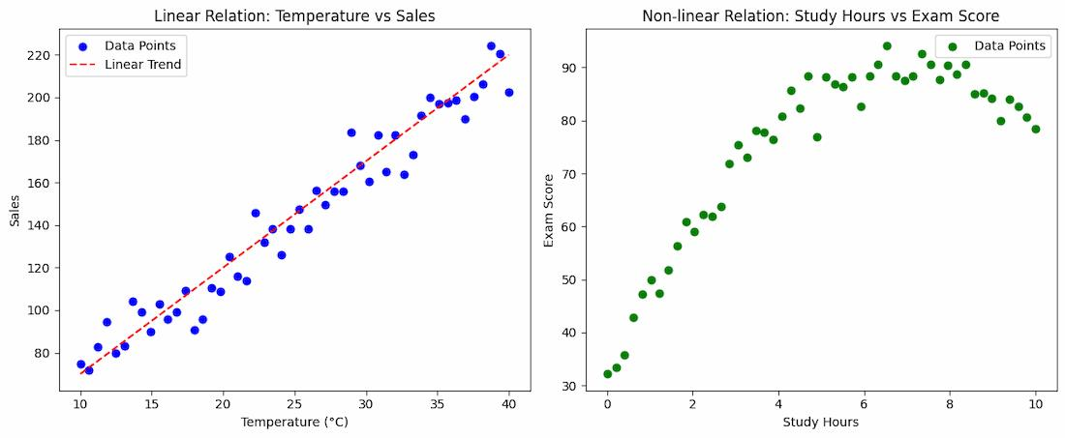
Linearity: residual structure reveals missing shape

Slide 27
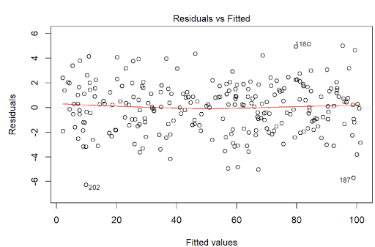
Independence biological hierarchy strikes back
Same patient/object
Same animal
Technical replicates
Repeated visits or tissues
Repeated measurements
Repeated assay of one sample

Slide 28
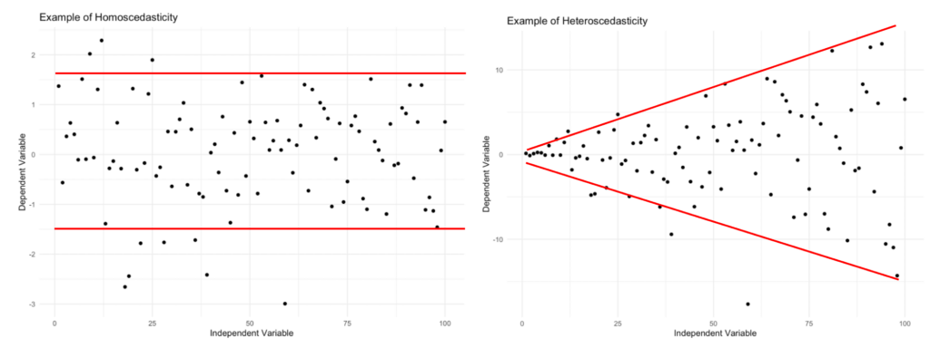
Homoscedasticity
Does residual spread remain similar across fitted values?

Slide 29
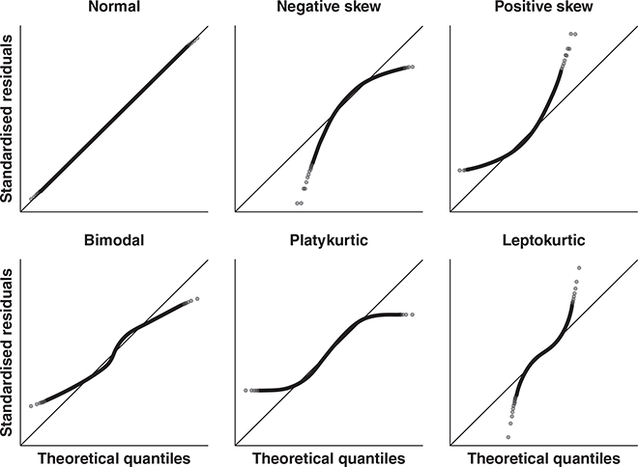
Residual normality
For classical inference, are residuals approximately compatible with the assumed error distribution?
The predictors themselves do not have to be normal.

Slide 30
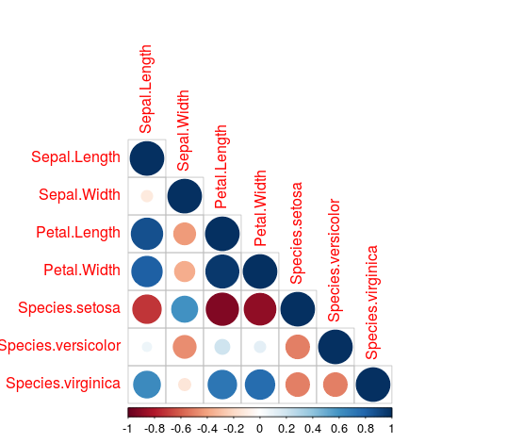
Multicollinearity
Are several predictors carrying nearly the same information?
Answer: PCA

Slide 31
7. Evaluation and generalization
Model is useful when it performs appropriately on unseen biological observations.

Slide 32
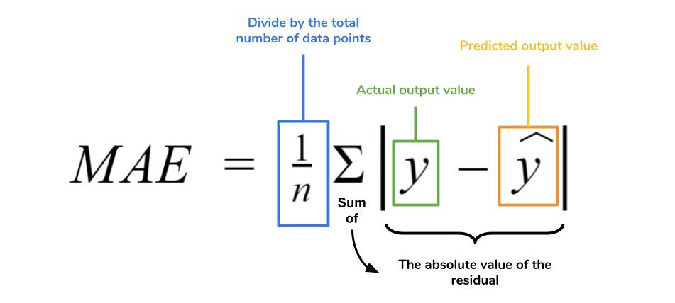
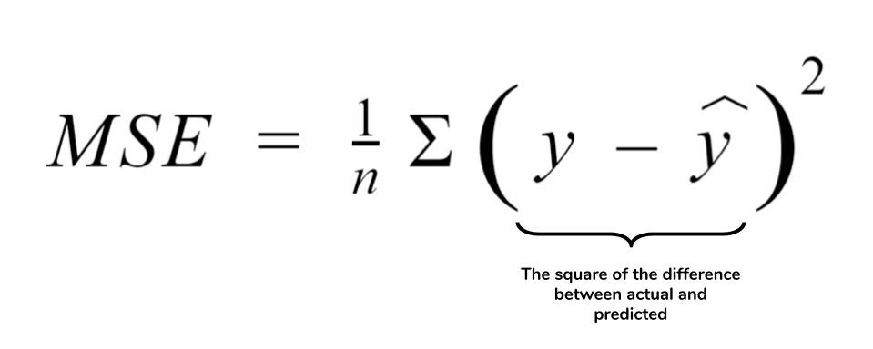
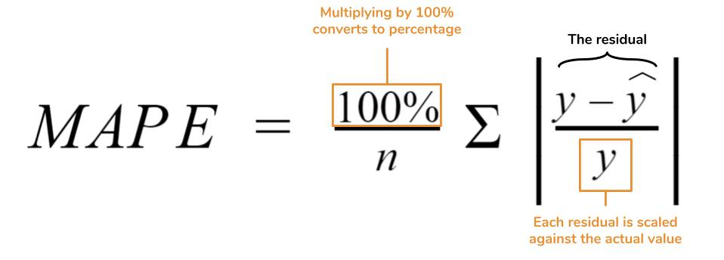
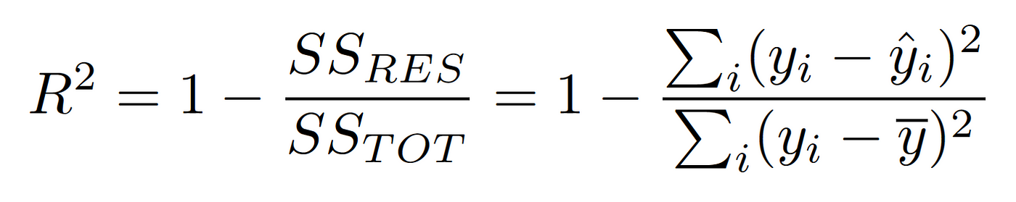
Regression metrics summarize different aspects of error
MAE
MSE
MAPE
R²
Mean absolute error
Typical absolute prediction error.
Same units as y.
Mean squared error
Penalizes large errors strongly.
Squared units.
Relative representation of MAE
Useful for presentation.
Improvement relative to predicting the mean.
Not a percentage accuracy.

Slide 33
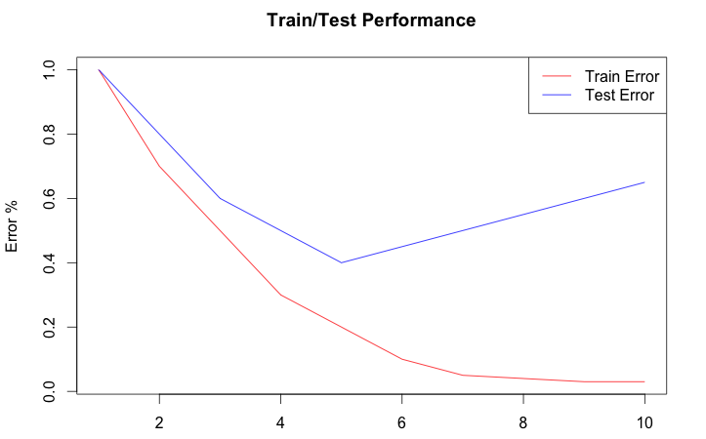
Training performance is not model quality

Slide 34
Linear regression is meeh
Works well when
• relationships are approximately linear
• interpretability needed
• effects are additive
• sample size supports the number of predictors
• as a baseline
Will fail when
• relationships are strongly nonlinear
• interactions are omitted
• extreme outliers dominate
• predictors are highly correlated
• p ≫ n
• repeated measures
• you need an actual model

Slide 35
Practical 2 — fit, diagnose, evaluate
Explore
Fit
Diagnose
Evaluate
Compare
Visualize quantitative relationships
Simple and multiple regression
Residuals and assumptions
MAE · RMSE · R²
Train vs test performance

